Slide 1

Module 5
Variable Screening
Notes:
Guidelines
Use section headers to chunk content in your presentation.
Use the same style of section header throughout your presentation.
Keep your title to no more than 2 lines.

Slide 2
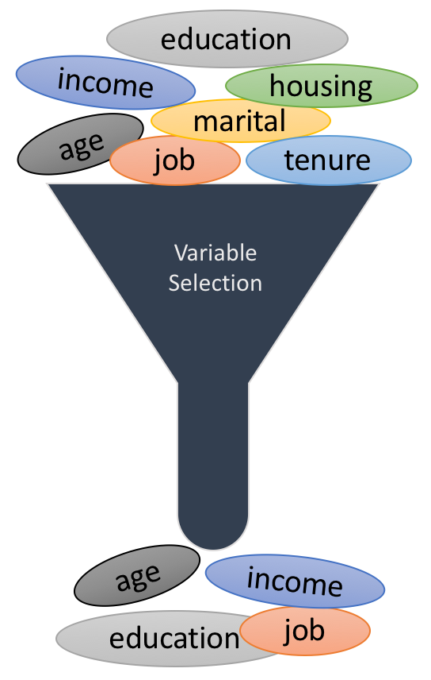
Variable Selection Metrics
Notes:
Guidelines
Use a title slide at the beginning of your presentation. There are 9 variations of title slides to choose from.
If you will have a series of slideshows, we recommend using the same style of title slide for each presentation.
Keep your title to no more than 2 lines.
Do not change the font style or font size of the title or subtitle.

Slide 3
Performance Metrics for Model Selection
We want a descriptive model with
A high R²
A high Adjusted R²
Low RMSE
Short Prediction Interval
For Predictive Models
A high R² Validation
Low ASE Validation
Low RASE Validation

Slide 4
Performance Metrics to Select Variables
Besides the metrics to select the best models. We can use:
AIC (Akaike Information Criterion)
BIC (Bayesian Information Criterion)
C_{p} Statistic

Slide 5
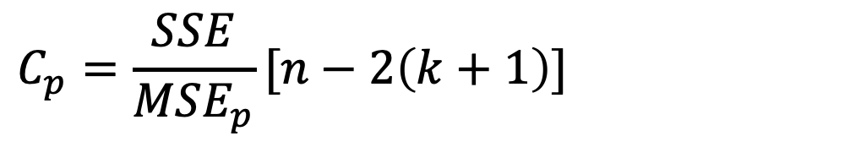

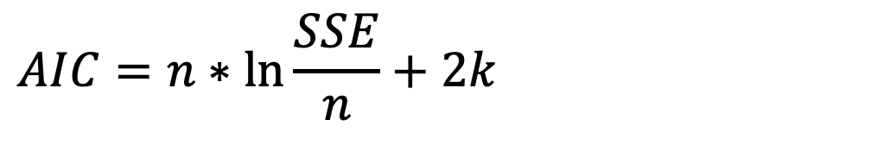
Performance Metrics to Select Variables
AIC (Akaike Information Criterion):
BIC (Bayesian Information Criterion):
C_{p} Statistic
$$AIC=n∗\ln{\frac{SSE}{n}}+2k$$
$$BIC=n∗\ln{\frac{SSE}{n}}+\ln{n}k$$
$$C_{p}=\frac{SSE}{MSE_{p}}[n−2\left(k+1\right)]$$

Slide 6
Variable Selection Techniques
Notes:
Guidelines
Use a title slide at the beginning of your presentation. There are 9 variations of title slides to choose from.
If you will have a series of slideshows, we recommend using the same style of title slide for each presentation.
Keep your title to no more than 2 lines.
Do not change the font style or font size of the title or subtitle.

Slide 7
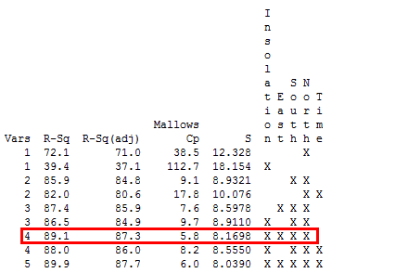
All-Subsets Regression
Tests all possible subsets of the set of potential independent variables.

Slide 8
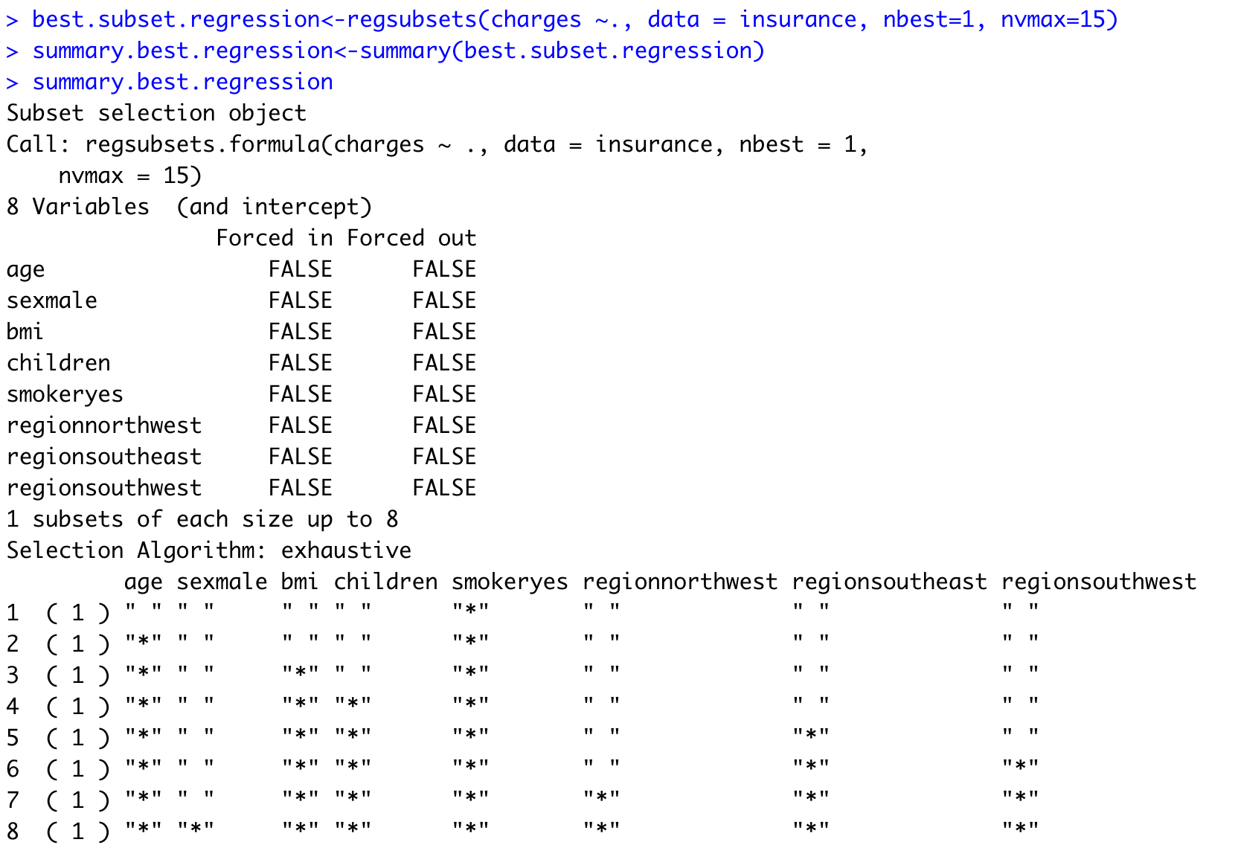
All-Subsets Regression
Tests all possible subsets of the set of potential independent variables.

Slide 9
All-Subsets Regression

Slide 10
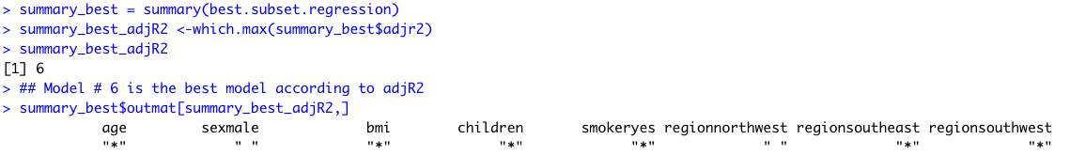
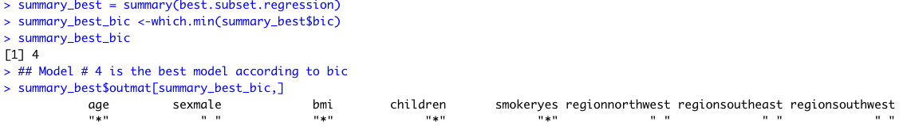
All-Subsets Regression
You can rank-order Best Models According to:
Example Based on Adj-R2:
Example Based on BIC:

